Slide 1
FailCon Country
City, Tentative Date

Slide 2
My Mission
Let us know why you think FailCon is important, especially for your city or country specifically.
What do you hope to change?
What does it mean to you?

Slide 3
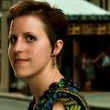
My Team
Your Name
What is your experience? What industry/ies do you work in? What will you focus on in this production? What are your strengths and weaknesses?
Who Else?
Who else is on your team? Why? What are their strengths, weaknesses, and background experience? Feel free to take more than one slide for team description.
Who Else?
Who else is on your team? Why? What are their strengths, weaknesses, and background experience? Feel free to take more than one slide for team description.

Slide 4
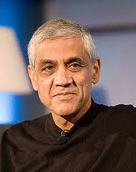
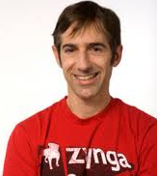
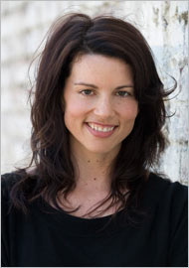
Possible Speakers:
Speaker Name + Title
How could you reach this speaker? Why are you interested in inviting them? Do they have a personal story of failure? This shouldn’t be a bio, this should be why they are right for your FailCon. (NOTE: These do not need to be confirmed speakers, of course, just people to give us a taste of who you’d invite.)
Speaker Name + Title
Also, think about diversity. Are you just listing men here? Are they all young? Are they all of European decent? We pride ourselves on the diversity of experience, history, race, gender, and creed that we share on the FailCon stage.
Speaker Name + Title
You should also feel comfortable taking 1-2 slides for speakers, if you have a lot of awesome ideas.

Slide 5
Possible Sponsors:
How do you know this partner? Why do you think they would get involved and in what capacity?
How do you know this partner? Why do you think they would get involved and in what capacity?
How do you know this partner? Why do you think they would get involved and in what capacity?

Slide 6
When Would You Host It?
This should just be a tentative date or time of year. We know you have not secured a final date yet, but we want to make sure you have a realistic production time line.
What venue could you host it at?
What venues might host it? Why do you like those? How would you set it up? How much would it cost? We also like photos.

Slide 7
Who Is Your Target Market?
Would you target early stage startups like most of our events? Would you also look at NGOs or big business or government? And how many people do you expect? (NOTE: Most first-time FailCon events have ~150 people.)
How Will You Reach Them?
Do you know local news channels? Entrepreneur groups? Meetup groups? Other events that will co-promote?
FailCon does NOT sell out with a few newspaper ads and a spot on Facebook. How will YOU sell your tickets?

Slide 8
Estimate Costs + Profits
How much do you think this will cost and why? Estimate venue price, food & beverage you’d provide, badge printing, sign printing, A/V, and any staff you may hire.
Then estimate profits. How much do you realistically think you’ll sell to sponsors? How much will tickets cost and how many do you think you’ll sell?

Slide 9
Thank you for your interest and for taking the time complete our FailCon Licensing application.
Is there anything else you think we should know? The more information we have on you and your idea, the better!
Then please send this to cass@thefailcon.com
We’ll review it, email you with any questions we have, and schedule a follow-up call on Skype within the next 10 days.
Thank you again!

